Slide 1
Reflection
By:
Dated:
Notes:
Hello, everyone. I hope you are doing well. In these slides, I will be presenting my reflection on the customer relationship management of Pilates Circuit.

Slide 2
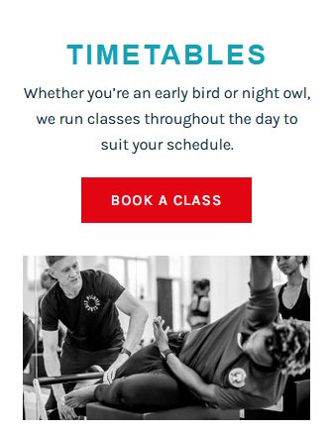
Introduction
Pilates Circuit offers a range of Pilates classes that are personalized to various needs.
The brand manages four studios in West London that are supported by an app and digital channels.
The brand focuses on wellness and community, and even personal growth for its customers (Pilates Circuit, 2024).
Notes:
Pilates Circuit is a health and fitness brand that specializes in Pilates. For example, the brand offers diverse classes that include including reformer, cardio, and advanced sessions, together with 1-2-1 options. With studios in West London and an online presence, the mission of the company is in line with improving wellness and community, and personal growth among their customers. However, there are challenges in the acquisition and retention of customers and inactive channels need improvements.

Slide 3
Customer Relationship Management
For the management of customer relations, there are Pilates Plus Perks for referrals and enough attendance.
The program, however, lacks personalization and appeal to a large number of people.
Due to low visibility and promotion, the program is not that effective.
Notes:
The customer relationship program of Pilates Circuit is Pilates Plus Perks, which usually rewards referrals and even regular attendance with different milestone incentives and complimentary classes. Even though the program helps in promoting loyalty, it lacks personalization for different customer needs and is not promoted properly across platforms.

Slide 4
Recommendations
For improving customer acquisition, there is a need for restarting channels of social media for improved visibility.
A campaign of “first class free” should be offered for new customers. For retaining customers, class recommendation and offers need to be personalized properly.
Loyalty rewards should also be improved further with different exclusive benefits (Kumar & Reinartz, 2018).
Notes:
For attracting new customers, Pilates Circuit should be engaging actively across different digital channels and restarting its accounts on Facebook and Twitter. A free introductory class should be offered as it can be helpful in attracting new people. On the other hand, the retention of customers should include different personalized strategies for classes on the basis of the preferences of customers. Moreover, improving the loyalty program with different unique benefits such as discounts can be helpful in improving the engagement of customers.

Slide 5
Reflection
With this project, I have learned to evaluate the data of customers and make actionable and effective insights.
I have obtained skills in the evaluation of customer engagement and even different loyalty proyrams.
However, I faced challenges in obtaining data about the customer relationship program of the business.
Notes:
Moving on, it can be said that this project has been quite effective for me as it has helped me in understanding customer behavior and determining which strategies should be implemented for improving both loyalty and engagement of customers. However, I faced a number of challenges in this project as well such as finding data on the program of customer relationship. It proved to be quite difficult and time-consuming.

Slide 6
References
Kumar, V., & Reinartz, W. (2018). Customer relationship management. Springer-Verlag GmbH Germany, part of Springer Nature 2006, 2012, 2018.
Pilates Circuit. (2024). PILATES CIRCUIT: Dynamic and Contemporary Reformer Pilates Group Fitness Classes. Retrieved 2024, from https://www.pilatescircuit.co.uk/
Notes:
Kumar, V., & Reinartz, W. (2018). Customer relationship management. Springer-Verlag GmbH Germany, part of Springer Nature 2006, 2012, 2018.
Pilates Circuit. (2024). PILATES CIRCUIT: Dynamic and Contemporary Reformer Pilates Group Fitness Classes. Retrieved 2024, from https://www.pilatescircuit.co.uk/

Slide 7
Notes:
Thank you all for your time. In case you have any questions, please feel free to ask me.

